Slide 1


IT Systems at University Centre Colchester
Phase 1 Induction 2025/26: Getting you Started

Slide 2
Getting Started

Slide 3

Getting Started
IT Security – Microsoft Multi-Factor Authenticator app to access all UCC systems.
Logging on to desktop PCs on campus.
Accessing Wi-Fi on campus– Eduroam app.
Notes:
Induction letter should have suggested to download Eduroam.
Need to do these before anything else.

Slide 4
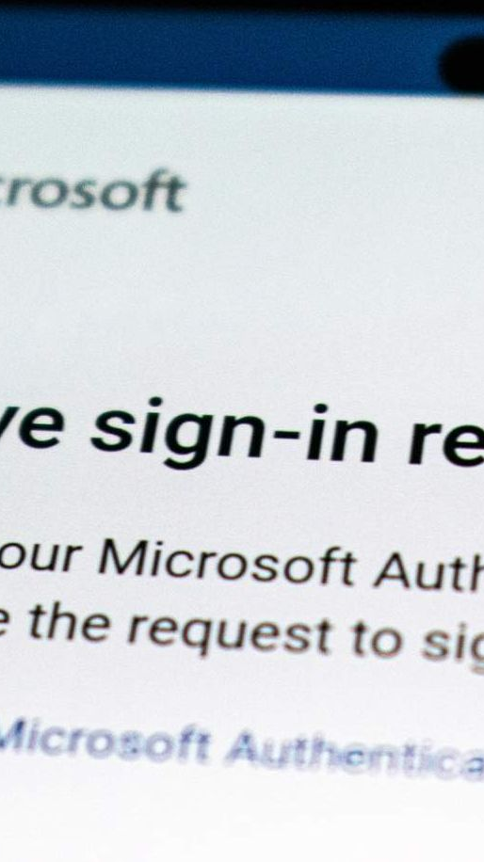
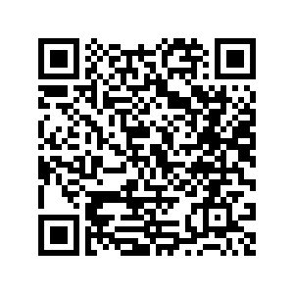
Multi-Factor Authentication (MFA)
To keep our systems as secure as possible, we use multi-factor authentication to allow access to most platforms and apps that we use at UCC. This means you will need to set up the MFA on your phone.
You will do this in two main steps:
  Download the Microsoft Authenticator app.
  Set up using the step-by-step guidance via this link.
Notes:
QR code takes you to the guidance BUT need to be logged on.
***You may benefit from opening up the step-by-step guidance.
Student action:
Download and set up MAF app.

Slide 5
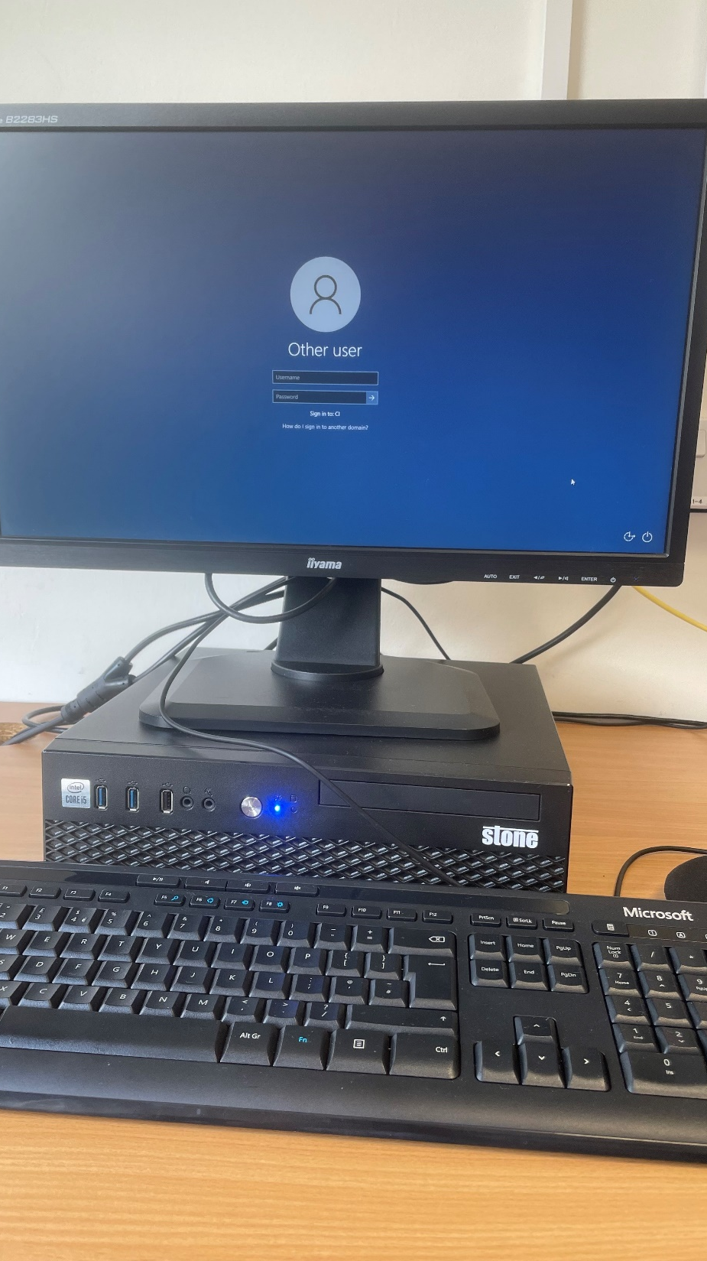
Accessing Desktop PCs
Login using your student email as follows:
  University username and finish with @colchester.ac.uk
  Therefore, if your name is Kevin Smith and your student ID number is 1509845, your username will be kevins9845@colchester.ac.uk
  Password is your student ID number which is on your lanyard
You will be prompted to change your password which you must do.
You can then access all the services that we will go through in this session. The first will be accessing your emails.
Notes:
Login on desktops before own devices.

Slide 6

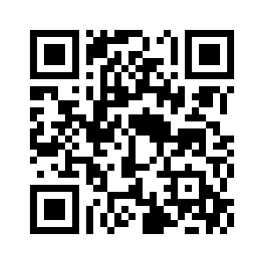
Outlook Email
Accessing your emails
You can access your student emails using Microsoft Outlook:
  On Campus: use the version of Microsoft Outlook that is installed on your college computer.
  Off Campus: use the web version of Microsoft Outlook.
The external link to access your emails is https://outlook.office.com/mail/ and you can also download the Outlook app.
You can also access your emails via the CI Connect app (more on this later).
Notes:
QR code takes you to email.
***Students to access their account while on campus.
Student actions:
Access your email account.
Save the external email link to your 'favourites'.
Consider downloading the Microsoft Outlook app.
Review the email support guides in your own time if you need further support.

Slide 7
Outlook Email
For further support using Outlook email check out:
Outlook 365 webmail using your browser.
Effective use of email course.
Information about phishing.
Notes:
***Students can look in their own time if need further help.

Slide 8

Outlook Calendar
You may also find that your teaching team will send invites to events, online sessions, tutorials etc. via your Outlook Calendar.
You should be able to view your Calendar through your email account.
Notes:
Get students to look at their calendar and explain how you use it.

Slide 9

Accessing Wi-Fi on Campus via Radius
Radius is a secure, international wireless (Wi-Fi) service available to all students at the Colchester Institute and UCC.
Radius allows you to use your University username and password to gain free wireless Internet access whilst at the Colchester Campus.
You will need to configure your device manually to use this for the first time. Go to your device settings and select Wi-Fi and find Radiu (New Eduroam Test) follow your device instructions and input your student email address and password. If you have an Android device, this link can help you further. Make sure you have changed your student default password before logging on.
By configuring your devices and signing in to Radius, you signify your agreement to all the below policies which you need to read:
Guidelines and Policies
JANET Roaming Policy
This Photo by Unknown author is licensed under CC BY-SA-NC.
Notes:
SOME COURSES MAY DO THIS ON A SEPARATE DAY WHEN USING THEIR OWN DEVICES. THIS IS YOUR CHOICE

Slide 10
Accessing Wi-Fi on Campus via Radius
Usernames
When setting up Radius, you must enter the username in the format universityaccount@colchester.ac.uk, where the college account is your university username. This is the same as your email address.
For example, if you are a student and your name is Kevin Smith and your student ID number is 1509845, your get Radius username will be kevins9845@colchester.ac.uk
This Photo by Unknown author is licensed under CC BY-SA-NC.

Slide 11
Microsoft 365 Applications

Slide 12

Microsoft 365 Overview
Microsoft 365 is a suite of apps that help you stay connected with the college and create work online. The following applications and cloud-based file storage platform are available free to you as a student:
  Outlook - Communicate with others using email
  Word - Create word-based files
  Excel - Create cell-based spreadsheets
  PowerPoint - Create slide show presentations
  OneNote – Digital notebook
  OneDrive - Secure, cloud-based file storage for your documents
  Teams - As students, you might use this for online tutorials and supervisions
Notes:
This follows on from the Outlook that you’ve just accessed.
This can be accessed on any device in or outside of campus

Slide 13
Microsoft 365 Overview
An overview of Microsoft 365 is available here.
You will need your student login details to access Microsoft 365.
As a student of Colchester Institute, you can download and install Microsoft 365 free of charge. More information can be found here.
All of your Office 365 applications can be accessed via the waffle icon – see image.

Slide 14
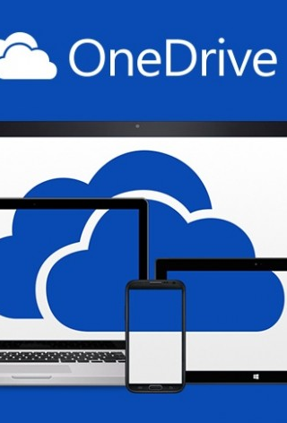
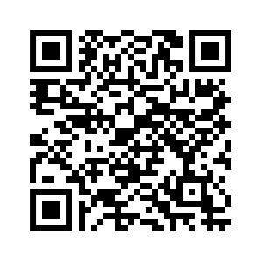
OneDrive
OneDrive is the Microsoft cloud service that connects you to all your files. It lets you store and protect your files, share them with others, and get to them from anywhere on all your devices.
OneDrive can be accessed externally via https://onedrive.live.com.
This Photo by Unknown Author is licensed under CC BY-NC-ND
Notes:
QR code takes to the OneDrive.
Students can look in their own time if need further help.

Slide 15
OneDrive
Further support if needed:
Working with OneDrive.
Finding files in OneDrive.
Logging in to OneDrive.
What OneDrive icons mean.
This Photo by Unknown Author is licensed under CC BY-NC-ND
Notes:
***Students can look in their own time if need further help.

Slide 16

Teams
MS Teams will typically be used for the following:
  Online lectures.
  Online tutorials and supervision meetings.
You will be provided with a link to join the session from your lecturer. You can join either via a web browser or via the Teams app if you already have a personal Teams account.
You should refer to the eSafety and ILT Code of Conduct Policy for Learners for appropriate conduct in a Teams session, however, simple expectations include:
  Prompt arrival
  Cameras on
  Mic muted where appropriate
  Participation.
This Photo by Unknown Author is licensed under CC BY-SA
Notes:
*** Please provide information specific to your course Teams calls, including links/calendar invites.

Slide 17
Teams
Using MS Teams
The following eLearning course will provide detailed information on how to use MS Teams if you are not familiar with using it.
This Photo by Unknown Author is licensed under CC BY-SA
Notes:
Student action:
Download the Teams app on your device.
Practice using the features of Teams.
Read the support guides if you would like more help.

Slide 18
UCC Systems

Slide 19

UCC Systems
Moodle
UCC Academic Services Moodle
Academic Skills Centre
Google Classroom
CI Connect app
Portal
ATS2
Printing
This Photo by Unknown author is licensed under CC BY.

Slide 20

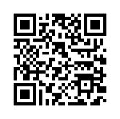
Moodle
Moodle is the virtual learning environment used by all UCC courses.
Course and module resources are published for students to access remotely or whilst on campus.
Some lecturers may communicate via Moodle too, which forwards an email to your student email address.
To access Moodle externally, please save the link: https://moodle.ccacolchester.com/
This Photo by Unknown author is licensed under CC BY-SA-NC.
Notes:
***All students to try and login to Moodle
***Need to register students to the Induction page.
QR code takes to the induction page.

Slide 21
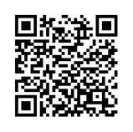
Moodle
Typically, most courses have a General Page and each module that you study will have a module specific page too which include:
  Module guides
  Weekly PowerPoint presentations
  Handouts
  URL links to useful web-based resources
  Independent activities
Please access your dedicated Induction Moodle page here now to access all the resources used today and for the next phases of your induction this semester.
This Photo by Unknown author is licensed under CC BY-SA-NC.
Notes:
QR code takes to Moodle external page.
***If you use Google Classroom instead, please amend this information. ***
***Please share links to your Moodle pages to login to and demo it.
Student actions:
Save the Moodle webpage to your 'favourites'.
Access and enrol on your course Moodle pages for each module that you are studying this semester. Save these links to your 'favourites'.
Access and enrol on your course General Page (if available). Save the link to your 'favourites'.
Review the Moodle pages for each of your courses in your own time.

Slide 22
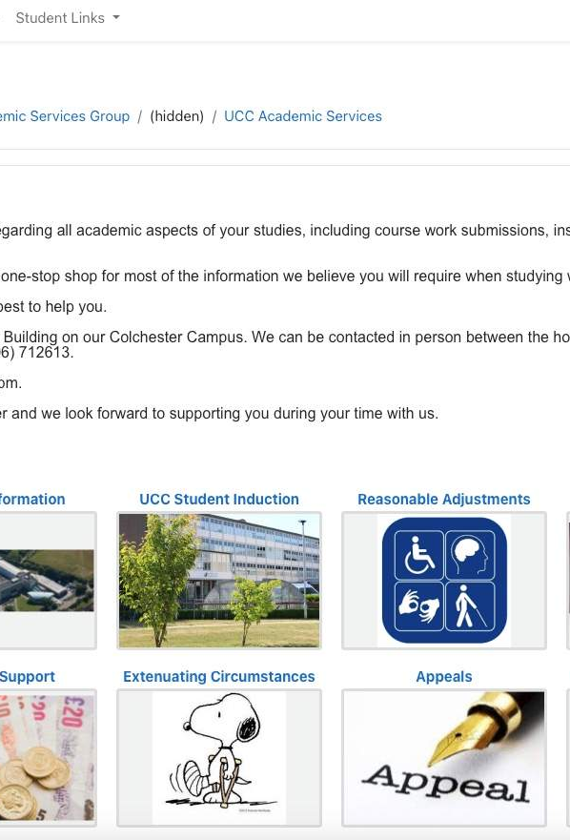
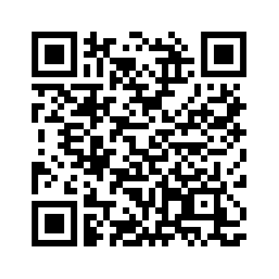
UCC Academic Services Moodle Page
UCC Academic Services is the go-to department for advice regarding all academic aspects of your studies, including course work submissions, institutional regulations, additional learning resources and advice, careers guidance and transcripts.
You can access this support by registering on the link here.
Notes:
***All students to enrol. QR code also takes to the page.
Student Actions:
Access and register on the UCC Academic Services Moodle page.
Save link to your 'favourites'.
Review content in your own time.

Slide 23

Academic Skills Centre (ASC)
The Academic Skills Centre provides academic skills support and online resources to all of our undergraduate and postgraduate students. These are accessible all year round and are designed to support you to succeed in your studies.
Services the ASC provides for students include:
  eLearning courses.
  Useful documents that can be downloaded and edited to suit your needs.
  YouTube videos to support your skills development.
  Bespoke sessions developed in collaboration with your Course Leaders.
  Scheduled face-to-face and online workshops that you can book onto.
Notes:
***All students to enrol
QR codes take students to the links

Slide 24
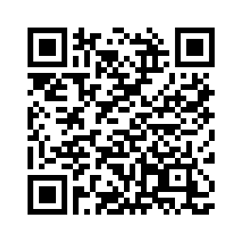
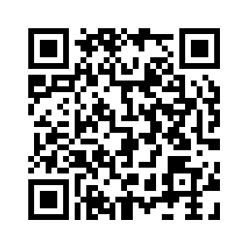
Academic Skills Centre (ASC)
You can access the ASC here.
Subscribe to the ASC YouTube channel here.
You will be asked to study the following courses during your first few weeks to ensure that you get off to the best start possible:
  Introduction to Academic Reading
  Note Taking
  Time Management
Notes:
QR codes take to the top two links.
***Note, there is no enrolment key now.
Student action:
Access and enrol on the Academic Skills Centre.
Save the Academic Skills Centre to your 'favourites'.
Save the Academic Skills Centre YouTube channel to your 'favourites'. Subscribe and turn on notifications if you want to be notified of newly created content.
Commence eLearning courses: Introduction to Academic Reading, Note Taking, and Time Management.
Prior to first assignment submission, complete the following eLearning course: Academic Integrity and Referencing; and consider completing the Academic Writing: Planning, Structuring and Proofreading eLearning course.

Slide 25

Google Classroom
Some courses use Google Classroom instead of Moodle to store resources and communicate with you, whilst other courses will use Google Classroom as an interactive teaching tool.
Your lecturers will confirm how your course or modules might use it.
Further information about how to use Google Classroom can be found in the eLearning here.
This Photo by Unknown Author is licensed under CC BY-SA
Notes:
***Please advise if you are using Google Classroom. Remove if not relevant.
*** Further information on Google Classroom is available ia the eLearning link. It is very comprehensive.
*** Add links to your Google Classrooms where possible

Slide 26
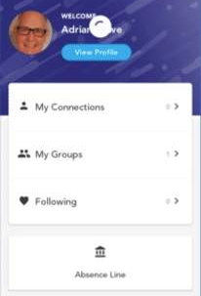
CI Connect App
CI Connect enables you to connect, communicate and collaborate with each other, your tutors and other staff, safely and securely.
The use of the app varies between courses. It is, however, useful for accessing your timetables, room numbers as well as keeping up to date with what is happening in the wider College.
You can also access your emails, Moodle and report absence from the app.
Notes:
All students can use this even if course teams do not.

Slide 27
CI Connect App
Download the CI Connect app from your app store.
Login with your student email and password (student ID number) e.g.
  Username: chrisa12979@colchester.ac.uk
  Password: 12979
More details can be found here.
Notes:
Student actions:
Download and login to the app.
Access your timetable.
Take time to explore the app further.

Slide 28
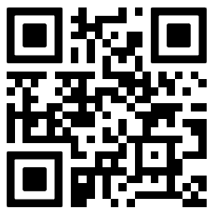
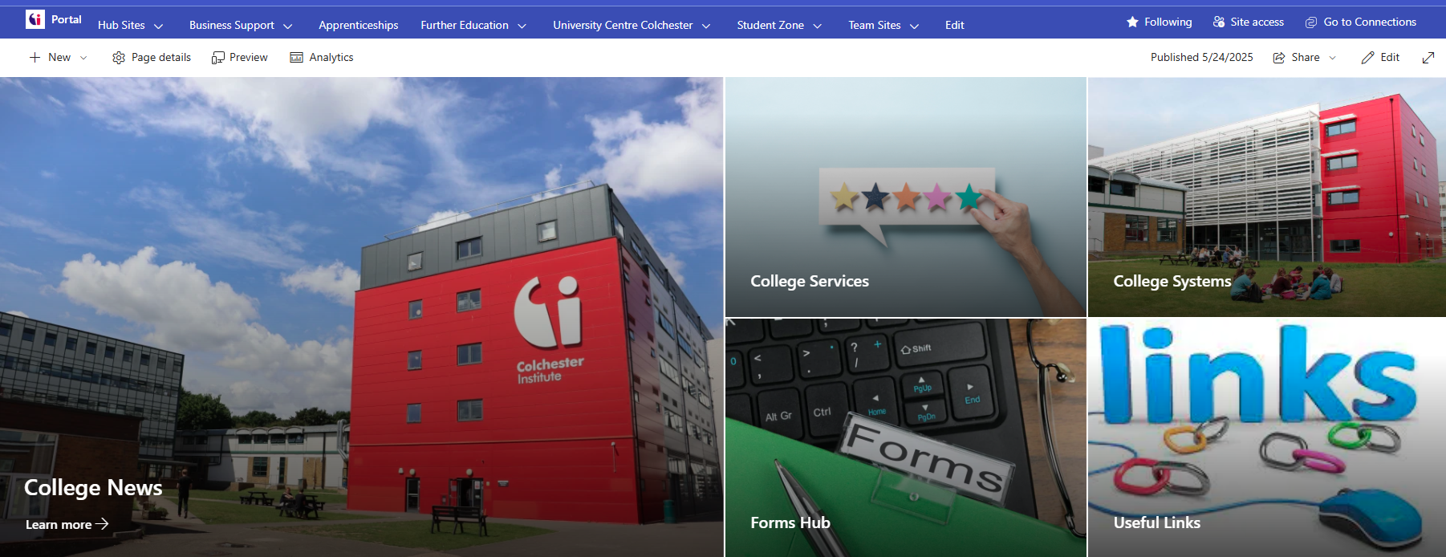
Portal
The Portal is Colchester Institute's intranet. The system is also used as a gateway to students for items such as Moodle and the Library catalogue.
You can access the Portal here and will need your student login details to access the Portal.
Notes:
***Take a moment to show the Portal – SHOW WHAT IS RELEVANT e.g library, student zone, upaychilli etc.
Student action:
Access the student portal.
Save the Portal link to your 'favourites'.
Review the content in your own time.

Slide 29

Assignment Submission - ATS2
Most of our courses (apart from ITE students) use ATS2 to support assignment submissions. You will receive an email each time work has been marked and feedback is ready for you to collect.
You will be given more guidance on how to use ATS2 to submit your work and access your grade and feedback later in the semester during Phase 3 of your induction.
The external link can be accessed here: https://ats2.colchester.ac.uk
Notes:
***This is a long way off. This will be done in Phase 3 of induction.
Student action:
Study the ATS2 guidance nearer to your first submission hand in date.
Save the ATS2 link to your 'favourites'.

Slide 30
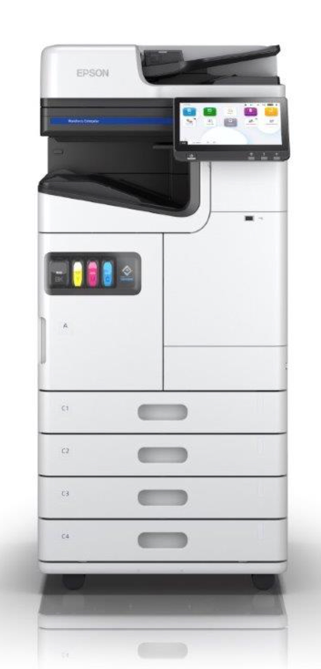
Printing on Campus
We have printers stationed across campus where you can print from our networked desktop computers. You can also use them to photocopy or scan documents too.
Registering your ID Card
The first time you use the printer you need to register your ID card. Click here for more information.
On your first time, we recommend you do this in the library or outside of UCC Academic Services to ensure someone is available to help if you need it.
Notes:
***Can click on the link in own time.

Slide 31
Apprenticeships
Please note, this section is for apprentices only.
Notes:
***Skip past if not apprenticeship programme

Slide 32

Apprentices Only
In addition to the systems used by UCC students, you will also be using the following system:
  Smart Assessor
You will be provided with further guidance on this by your Assessor Coaches.
Notes:
Team to decide when to train on these.

Slide 33
Apprentices Only:
Smart Assessor
Smart Assessor is an electronic collection of your skills and knowledge assessed against a standard or qualification and replaces paper portfolios.
You can replace paper evidence with videos, photos and voice recordings as evidence of competence and the portfolio. Smart Assessor is always available, both offline and securely on the web.
Click here for Apprentice guide to using Smart Assessor
Click here for Uploading and Mapping Evidence
Click here to access Smart Assessor
Notes:
Team to decide when to train on these.

Slide 34
Student Responsibilities

Slide 35

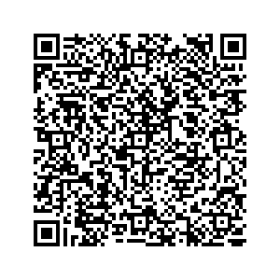
Student Responsibilities
eSafety and ILT Code of Conduct Policy for Learners
It is important that all of us take actions to keep ourselves and others safe online.
Colchester Institute (CI) has a eSafety and ILT Code of Conduct Policy for Learners which you must read; by completing this course you have confirmed that you have read and agreed to this policy.
It is very important that you use CI IT systems appropriately. If you do not, it could result in disciplinary action against you and even exclusion from the College.
Maintain your Student Email Account
It is important that you regularly check your UCC email account, particularly on the day before, or in the morning of lectures in case there are any important changes that you need to be aware of.
This will be the main communication channel during your time at UCC and responsibility lies with you to keep up to date with communications and respond in a timely manner when required.
Notes:
***Demo the Learner IT acceptable use agreement. Can also be accessed via the QR code.

Slide 36
ILT Support

Slide 37

ILT Support
ILT Service Desk
If you have an IT problem, or cannot access our systems, the ILT department has a dedicated system support centre which can be contacted via:
  ILT Service Desk Portal
  Emailing iltservicedesk@colchester.ac.uk
  Calling 01206 712222.
  Drop in to the ILT Service Desk in Room B308, B Block in the main block.
FAQs
You might benefit from using this link to access commonly asked questions about our systems.
Notes:
Student action:
If anything isn't working, please contact the ILT support desk

Slide 38
What Next
There are several actions to undertake. For a variety of reasons, you may not have been able to action all these today.
Firstly, please don't worry! We have a checklist on the Induction Moodle page to remind you of what to do; you will also find a copy of this presentation, as well as an eLearning course on our systems to that you could study as well.
We also have some scheduled drop-in sessions next week that you can attend too.
Notes:
Student action:
If anything isn't working, please contact the ILT support desk

