Slide 1
Welcome to Initial Teacher Education(ITE)
Induction Session
Course Leader: Kayleigh McLaughlin
Kayleigh.mclaughlin@colchester.ac.uk
01206 583860

Slide 2
Agenda for this session
Introductory talk
Introductions and Course information (session structure)
Guest speaker (Helen Lee)The PGCE/CERT-ED/ Apprenticeship
Recommended reading
The professional standards
Accessing the online platforms required for study
Pebblepad

Slide 3
House Rules
Domestics: Agree start finish times/ break times
Toilets
Fire Alarm: Testing not expected, if it rings, go to the Assembly Point
Mobile phones on silent please.
Name labels to help me remember who you are!

Slide 4
Expected workload
Attendance (80% minimum)
Participation in class activities- Timetabling (breaks and end of session)
10 observations (5 per year)
Course written work is to be at Level 4 (1st year), learners are expected to work independently on assignments in own time and upload by set deadlines to Pebblepad/ SMART Assessor. There will be time allocated within the sessions to complete activities/ tasks which ilvaite workload.
Any questions?

Slide 5
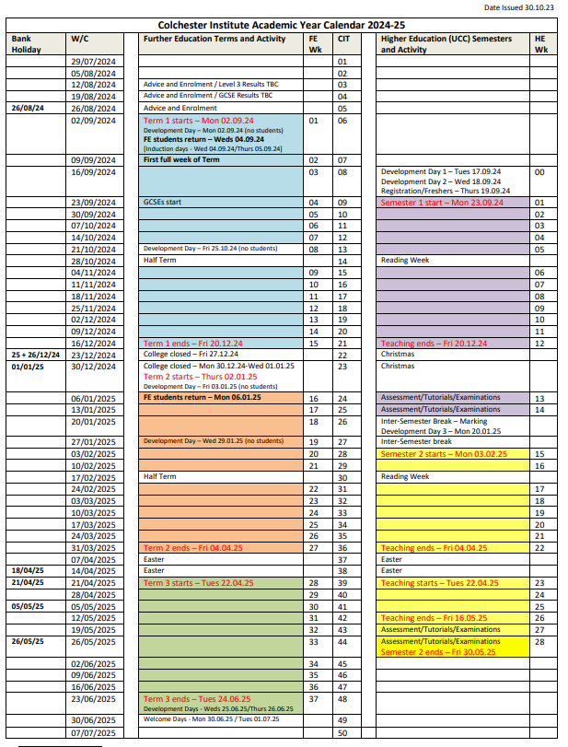
Important dates
October half term
Christmas break
February half term
Easter break
Friday 23rd May 25

Slide 6
Books to support your study

Slide 7
Getting to know you…
If you could have an endless supply of food, what would you get?
If you were an animal, what would you be and why?
What is your favourite thing to do in the summer?
If they made a movie of your life, who would play you and why?
If you were an ice cream flavour, which one would you be?
If you could visit any place in the world, where would you go?

Slide 8
Why do you think I asked you a question?
How will this help me remember you?
How do you feel in front of a group of new people?

Slide 9
What is the PGCE/CERT-ED course?
Guest speaker Helen Lee (Year 2 tutor)
Consists of four modules, two this year and two next year.
10 observations five this year
and five next year
All modules are 30 credits, module 1 is level 4, module 2 is level 5.
We follow the HE academic Calendar
PGCE
Cert Ed
Notes:
Ice breaker, NVC’s,

Slide 10
What is the apprenticeship route?
Level 5 Learning and Skills Teacher
18 months (not including End Point Assessment) (EPA)= 1 year and 1 semester
9 Duties to include- Knowledge (20) Skills (25) Behaviours (B6)
EPA= Assessment method 1. Observation: lesson observation and professional dialogue
Fail, pass or distinction
EPA= Assessment method 2. Professional discussion underpinned by a portfolio of evidence:
Fail, pass or distinction

Slide 11
Consider your learning journey
Module 3
Level 5
Module 4
Level 5
Apprenticeship evidence (EPA) & QTLS
Cert Ed
Module 1
Level 4
Module 2
Level 5
Module 3
Level 6
Module 4
Level 6
PGCE
Professional
Graduate
Module 3
Level 7
Module 4
Level 7
PGCE
Postgraduate
Graduate

Slide 12
Assessments
Your learning platform will be Google classroom
All formal/summative assessments via Moodle for originality software and on Pebblepad
All work must go on Pebblepad/ SMART Assessor.
Pebblepad is the device which is reviewed to evidence that you have completed the programme.
Feedback for assessments by formative and summative is posted on Pebblepad.
Results at end of year is emailed via your University of Huddersfield email address.
Late submissions / Extenuating Circumstances / Deadlines (Yellow and Black)
Academic Offences – Academic integrity module

Slide 13
ASSESSMENT RULES
All deadlines are at midday on
All modules are compulsory
Less than 40% = Refer (Fail)
40 – 45% = Broadly Satisfactory Pass
46 – 59% = Sound Pass
60 – 69% = Merit
70%+ = Distinction
We mark against the assignment guidelines and criteria
We check against the learning outcomes and assignment weighting
The feedback will match the weighted sections

Slide 14
Teaching observations
You will need to keep an observation file with all of the relevant forms in them for the observer and your mentor.
Session plan, pre-session, rationale, resources
& reflection after
the feedback from the
observer

Slide 15
Absences
As per any student please inform the student absence line.
Your responsibility to go on Google Classroom and catch up.
If long term, please contact your Course Leader: Me (Kayleigh.mclaughlin@colchester.ac.uk)

Slide 16
Student Council Member
Each course is asked to provide two names for a student council member (formally known as Course/Student Rep) (1 student for this group and one from the other group)
The role of a student council (student engagement policy)- updated 13/09/24 on the main portal but I will provide the link on GC
Consideration for ‘Student Council?’ (Cape not included!)- Nominees required next week
Termly Programme Forum meetings (programme specific)
Termly Learning and Teaching Forum meetings (all students on the council)
Not onerous but important.

Slide 17
Final random items to cover
The library- Library induction 4-5pm Next week 24th & 26th Sep ☺
Wellbeing and disability services
Careers and employability
Student finance/ HR funding
UCC Academic Services (Tracy Blair and Di Whant)
Anything questions?
See you back here at 5:30pm

Slide 18
20 Professional Standards

Slide 19
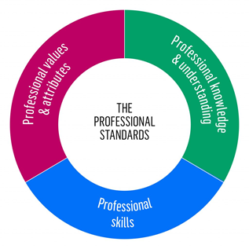
20 Professional standards
The three domains of practice
They consist of 20 standards organised into three domains of practice.
Professional Values and Attributes
Seven standards to help you develop your own judgment of what works and does not work in your teaching and training.
Professional Knowledge and Understanding
Five standards which highlight the importance of subject knowledge, teaching expertise, knowledge-sharing, supporting learners with educational difficulties, and professional responsibilities.
Professional Skills
Eight standards which support you to master planning, motivation, coaching and assessment strategies to enable your learners to make excellent progress.

Slide 20
Let's get technical

Slide 21
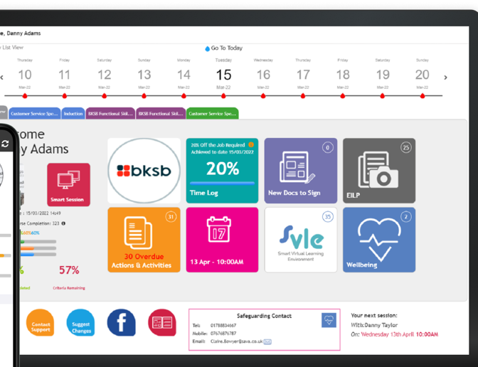
Introduction to the portal,
Google Classroom,
Moodle, Pebblepad & Brightspace, SMART Assessor

Slide 22
You need to be able to get onto the following ready for next session (ideally):
Moodle/ SMART Assessor
Google Classroom
Visit the ETF website :https://www.et-foundation.co.uk/professional-standards/teachers/

Slide 23
WHAT’S ON MOODLE?
Once your UCC login is set up, you will be able to log in to Moodle. Your log in for Moodle is the same as your college log in
Each module has a separate Moodle page
You will need to enrol on each Moodle page. The key is ‘teach’ for all pages
Click here to go to all associated Moodle pages for the PGCE/Cert Ed:https://moodle.ccacolchester.com/course/index.php?categoryid=607

Slide 24
Google classroom
Your Google classroom class code is:4csvo3d https://classroom.google.com/c/NzEwNTc5Njg5MTE1?cjc=4csvo3d
Your learning materials will be accessible here and tasks set during sessions will be completed on this platform.

Slide 25
Good interactive tool!
Education and Training foundation website- Professional standards and CPD
Society for Education and Training (SET membership is free for trainee teachers)
About SET | Society for Education and Training (et-foundation.co.uk)

Slide 26
Pebblepad- We may need to do this next week
Log-in to PebblePad
Your Username and Password will be the same as your University login details.
Logging in: Use your University username (u1234567 or sedu...) and password to login to PebblePad (opens new window)

Slide 27
Tasks to be completed
Complete the online UCC student induction –Academic integrity quiz https://moodle.ccacolchester.com/course/index.php?categoryid=705
Try Pebblepad - https://v3.pebblepad.co.uk/login/huddersfield (google University of Huddersfield Pebblepad.
Log on to the Moodle page for module 1 and module 2 –
https://moodle.ccacolchester.com/course/index.php?categoryid=620
Enrolment keys – Module 1 = teach Module 2 = teach
https://forms.office.com/Pages/ResponsePage.aspx?id=2p8utZEGhUW9_FzK4c4YkCV1gDPgIiVGsHfyl7NXy7RUN1AwRFZEMjFZQjlESFZPVVg0R09VQU1TQS4u Huddersfield registration form

Slide 28
Any Questions
Thank you for coming! Take care ☺

